Slide 1



INSERT PHOTO
All About
Angelman Syndrome
and your friend
(insert name here)

Slide 2


What is Angelman Syndrome?
Angelman syndrome (AS) is a rare disorder that occurs in 1 in 15,000
or 500,000 people worldwide.

Slide 3


500,000 people in
the world have AS.
THAT’S IT!
How many people live in the US?
331.9 MILLION
How many people live in the world?
7.9 BILLION

Slide 4

Insert Name
is 1 of 500,000!
Meaning he is super unique and extremely special
INSERT PHOTO

Slide 5

So what
causes AS?
One gene (called UBE3A)
is missing or doesn’t work right.
That's it! Just that one gene
Well – what is a gene?

Slide 6
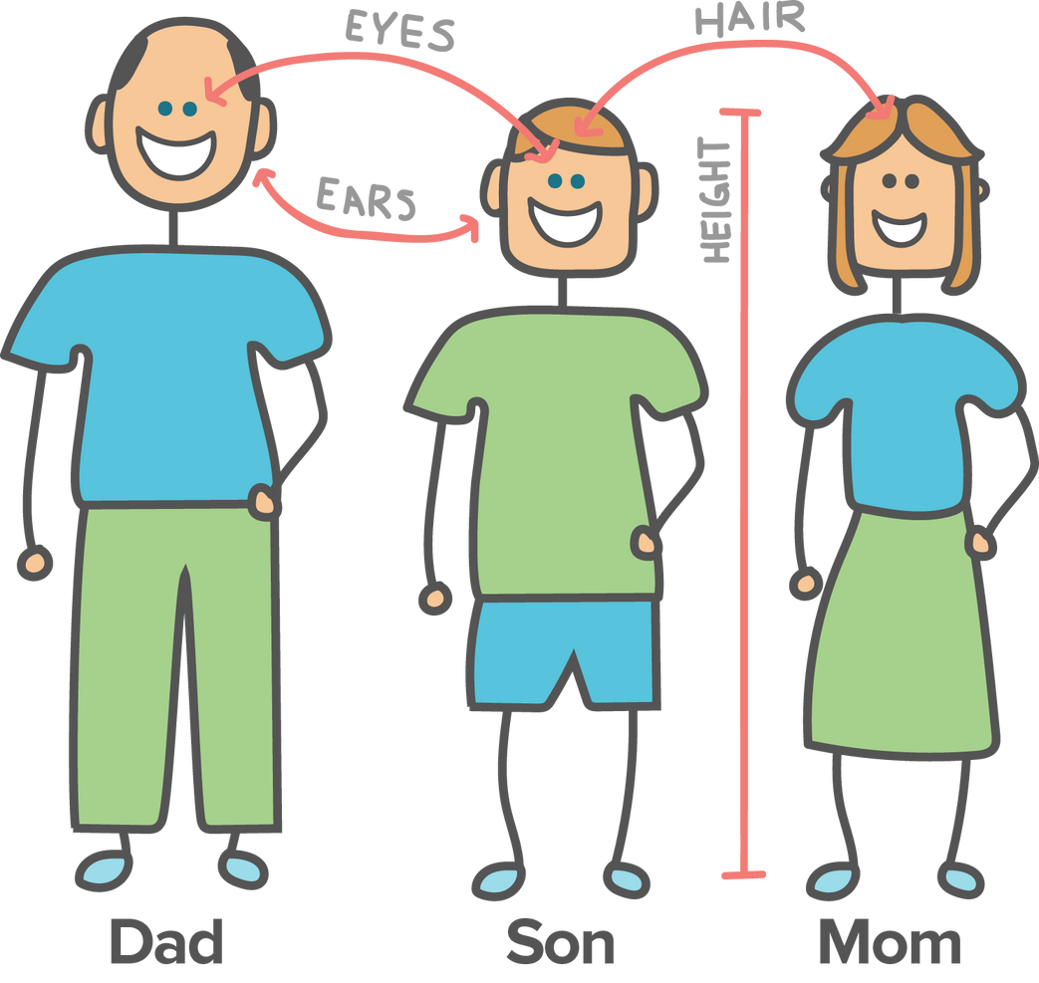
We each have hundreds of thousands of genes!
Genes are what make us different & unique.
Look around your class – in what ways are your friends different?
Hair color
Eye color
Height
Smile

Slide 7

Angelman Syndrome cannot be 'caught’
Kids with AS are born with it and there is no other way to get Angelman Syndrome

Slide 8


How do you think having
Angelman Syndrome affects your friend?
What are some of the things
they might do a little differently?

Slide 9
But look at all the things
(insert name) loves!
Do you love these things as well?
Swimming
Riding her / his bike
Shopping at Target
Playing on sports teams
Being with friends and family
Going to (fav restaurant)
Watching music videos
Eating favorite foods

Slide 10
Create photo collage of individual with AS out in the community; playing w friends;
playing with family; using AAC device; eating at a restaurant, etc

Slide 11

What about Communication?
How do you communicate your
wants and needs to your
parents, friends, teachers?
I want you to think hard…
if you could not verbalize (talk)
or write down what you wanted,
how would you communicate?

Slide 12

Example:
What would you do if you REALLY wanted munchkins from Dunkin Donuts, but you couldn’t tell your parents or write it down?
How would you react if they took you to the wrong place, but you can’t tell them it’s the wrong place?
What if you went to the wrong place again?
What would you do?
This is something that kids with AS deal with, they can’t always tell us what they want.

Slide 13
Other Characteristics
of Angelman Syndrome:
May need help walking
Enjoys being around other people
Likes to play with sensory toys
Can get frustrated when unable to communicate
Might like to hug
How many of you like or do some of these things as well? WE ARE ALL UNIQUE!

Slide 14

What Questions Do You Have About
Angelman Syndrome?

Slide 15
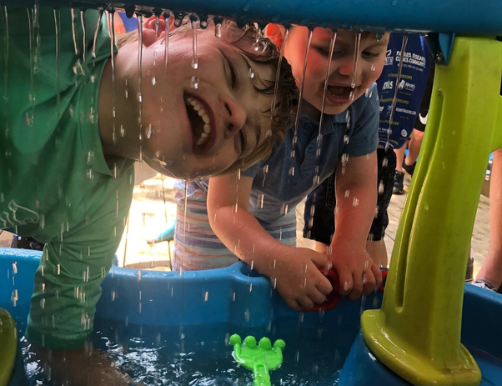
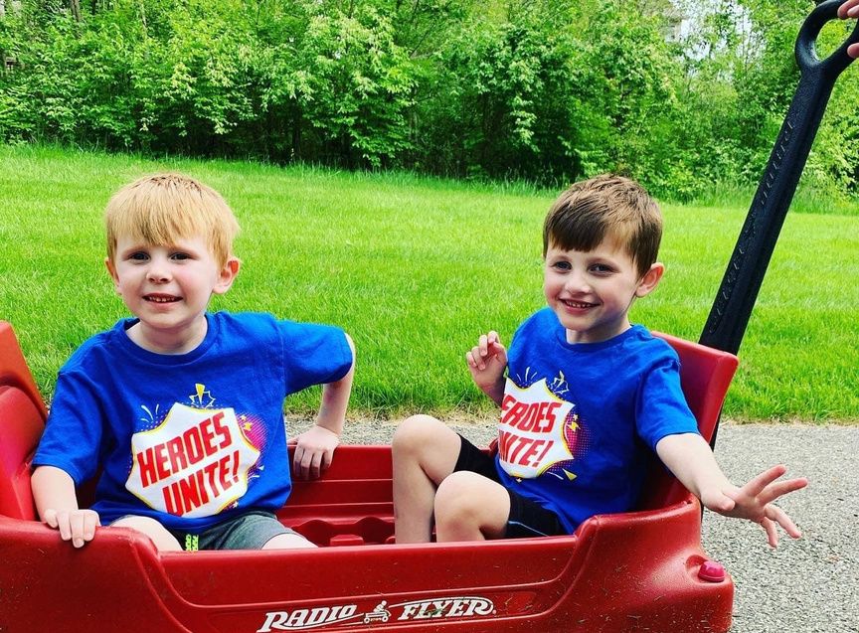

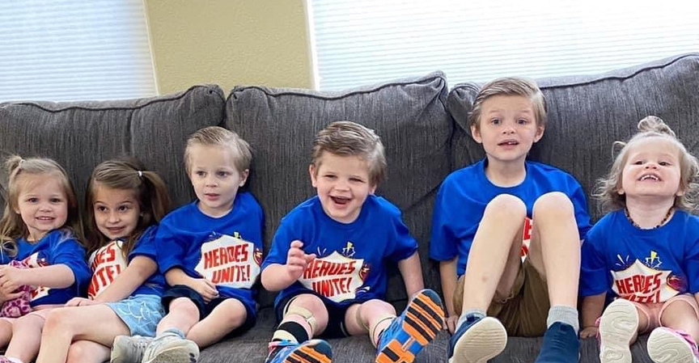
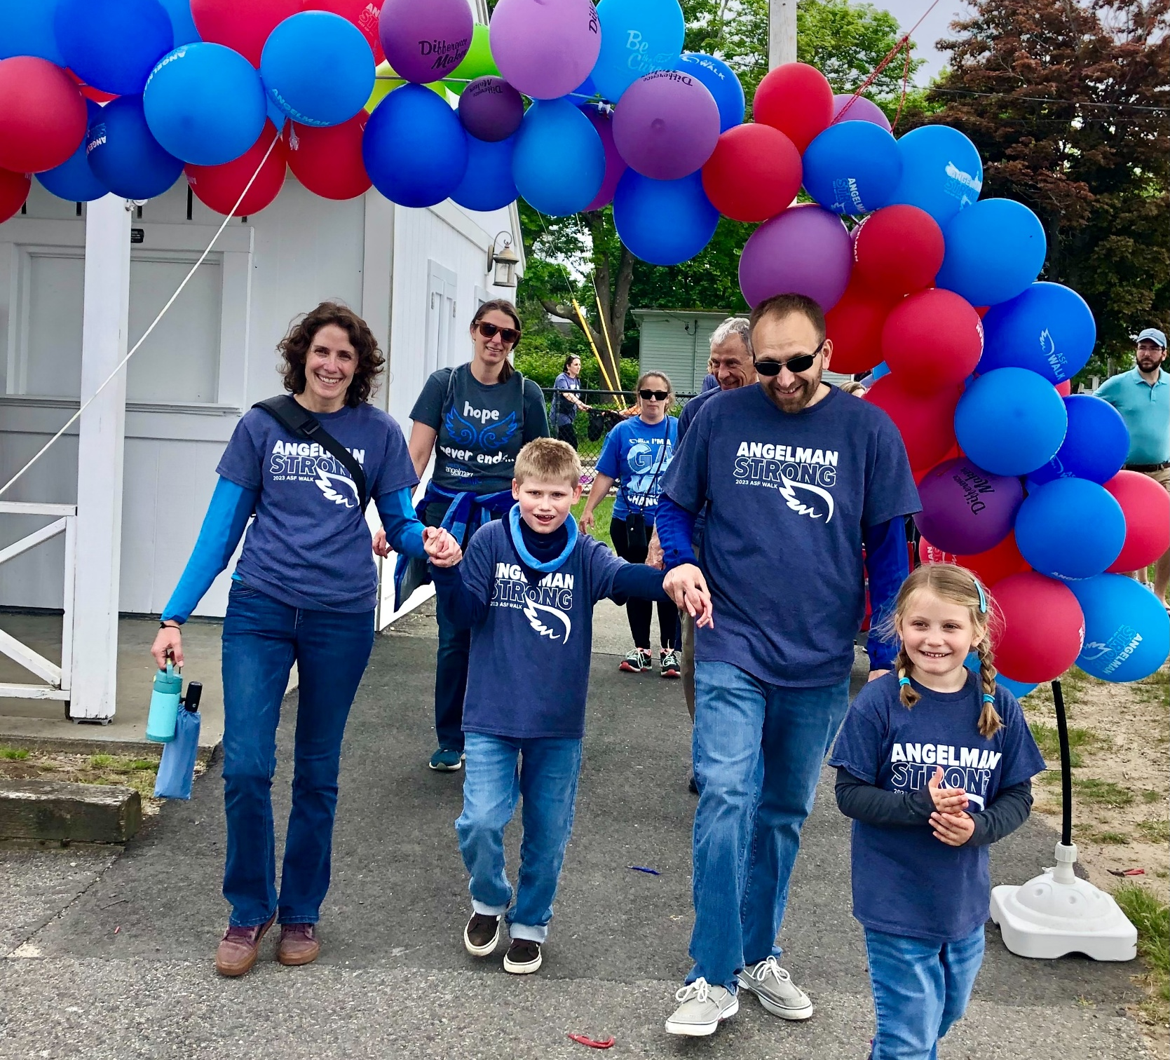
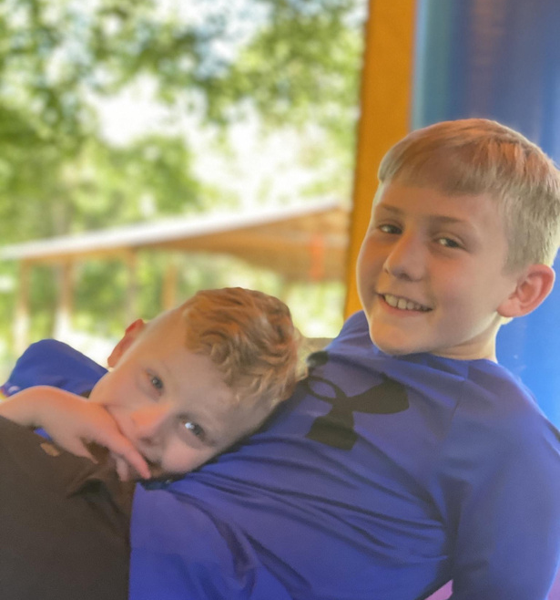
How can you be a good friend to (insert name) and other kids like him?

