Slide 1
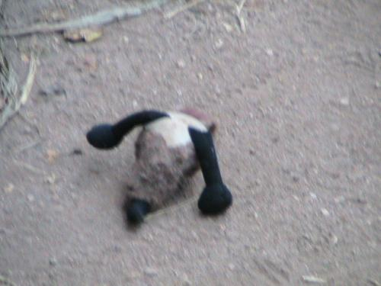
Where Is Speedy? Caroline Musselwhite

Slide 2
Where Is Speedy?

Slide 3
Where is Speedy?

Slide 4
He is on the vine. Chill out!

Slide 5
Where is Speedy?

Slide 6
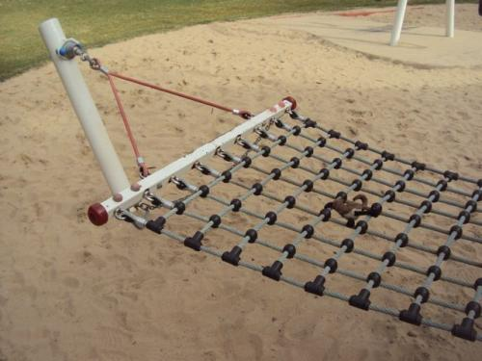
He is in the hammock. Cool!

Slide 7
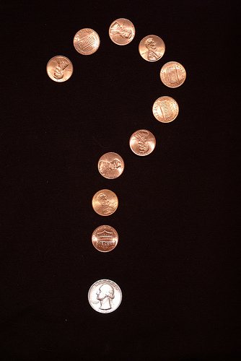
Where is Speedy?

Slide 8
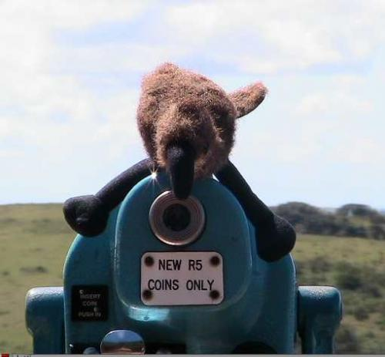
He is on the viewer. What do you see?

Slide 9
Where is Speedy?

Slide 10
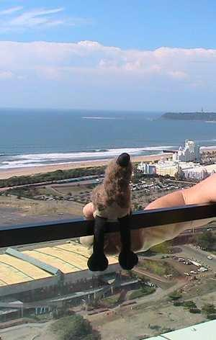
He is up. Too high, Speedy!

Slide 11
Where are you Speedy?

Slide 12
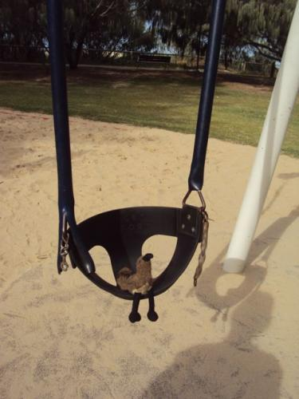
He is in the swing. You go!

Slide 13
Where is Speedy?

Slide 14
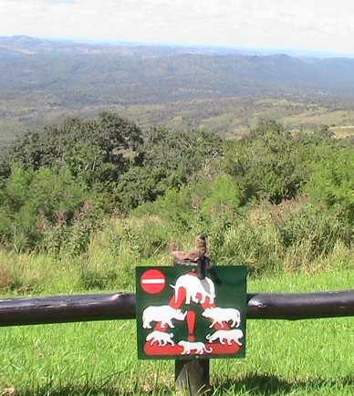
Look! He is on the sign!

Slide 15
Where is Speedy?

Slide 16
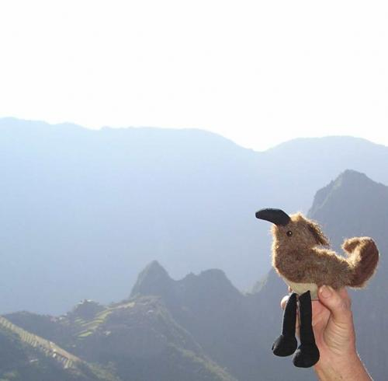
He is way up!

Slide 17
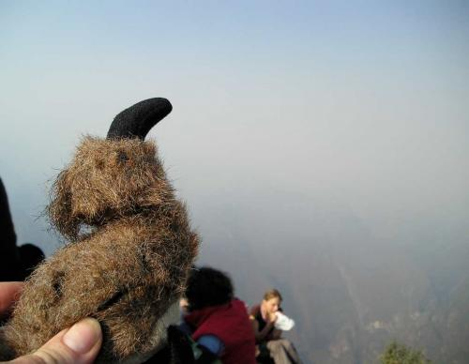
He is up up up! Get down Speedy!

