Slide 1
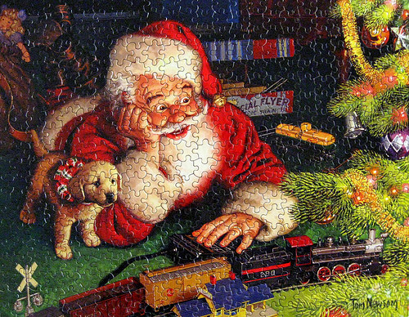
Where is Santa? Caroline Musselwhite

Slide 2
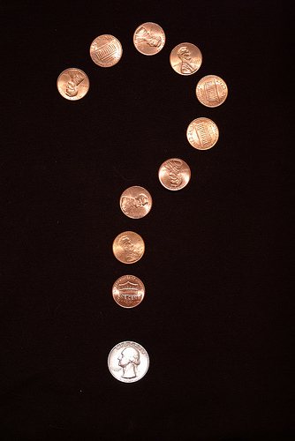
Where is Santa?

Slide 3
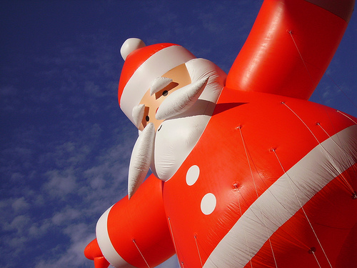
He is up!

Slide 4
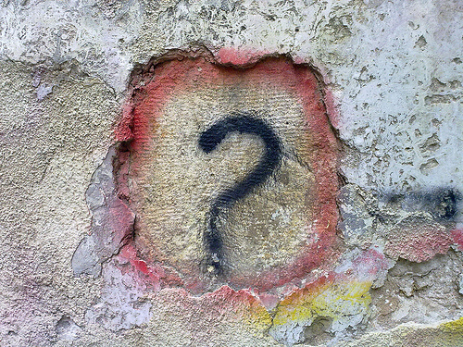
Where is Santa?

Slide 5
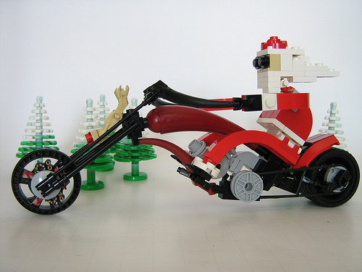
He is on his cycle. You go!

Slide 6
Where is Santa?

Slide 7
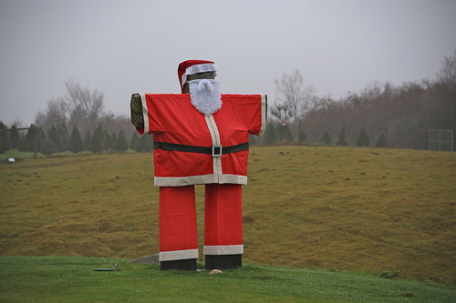
He is in the field.

Slide 8
Where is Santa?

Slide 9
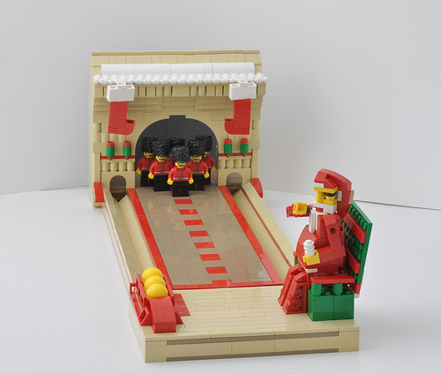
He is on his chair.

Slide 10
Where is Santa?

Slide 11
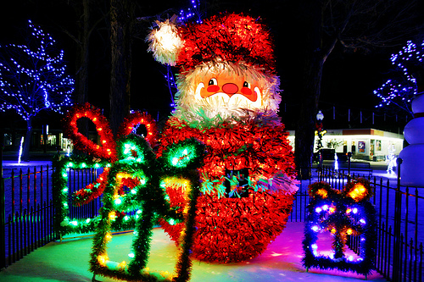
He is up on the roof!

Slide 12
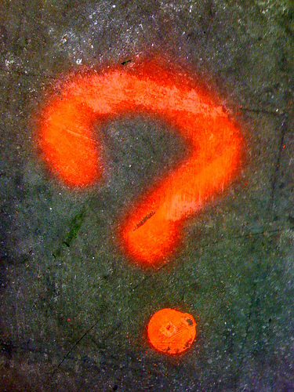
Where is Santa?

Slide 13
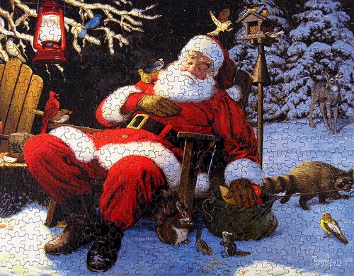
He is in his chair.

Slide 14
Where is Santa?

Slide 15
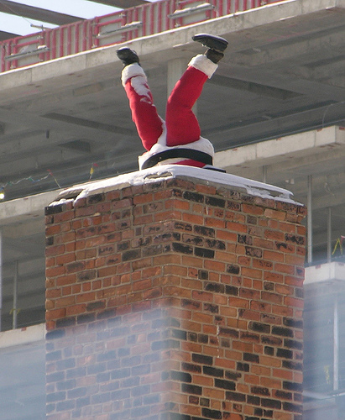
Help! He is stuck in the chimney!

