Slide 1
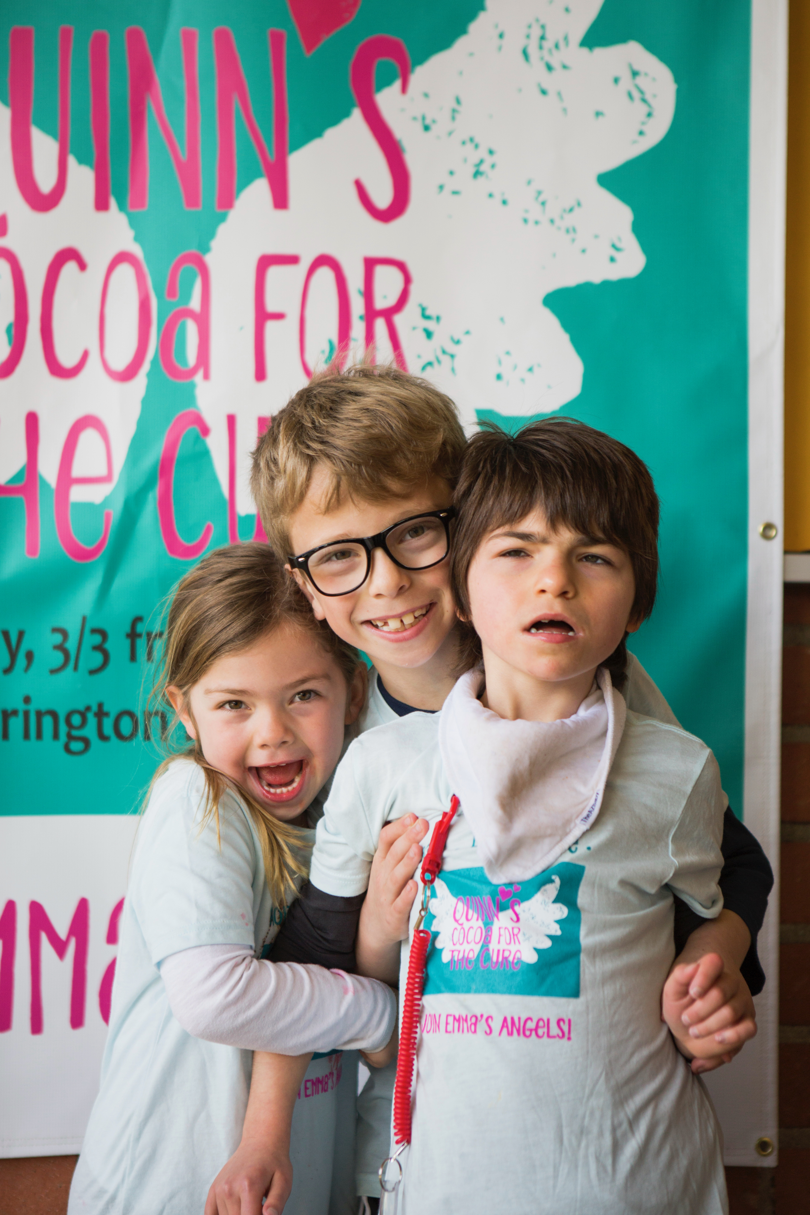
Your
Photo
Here
Thank you for supporting our event!
Your participation is one small way we can support our loved ones with Angelman syndrome.

