Slide 1
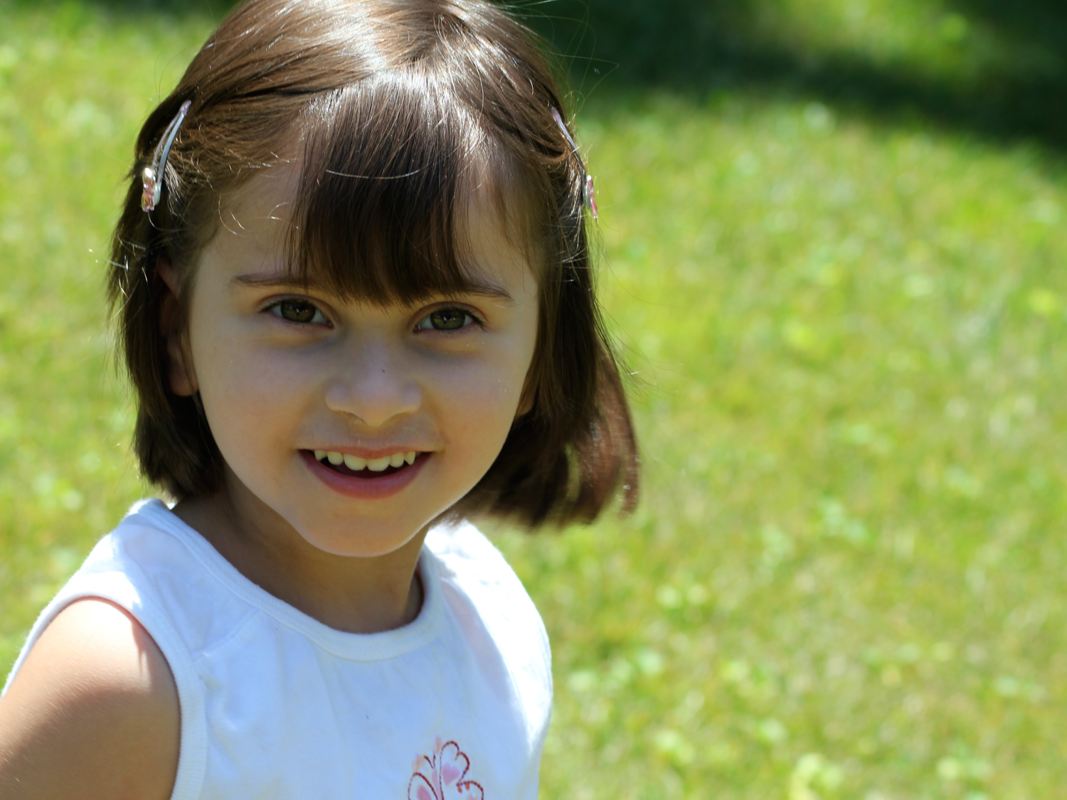
What is Angelman syndrome?
Notes:
Hello and welcome

Slide 2
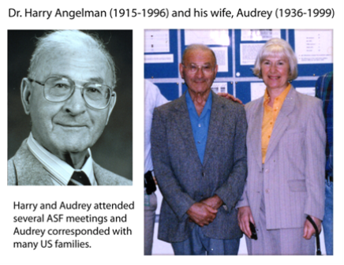
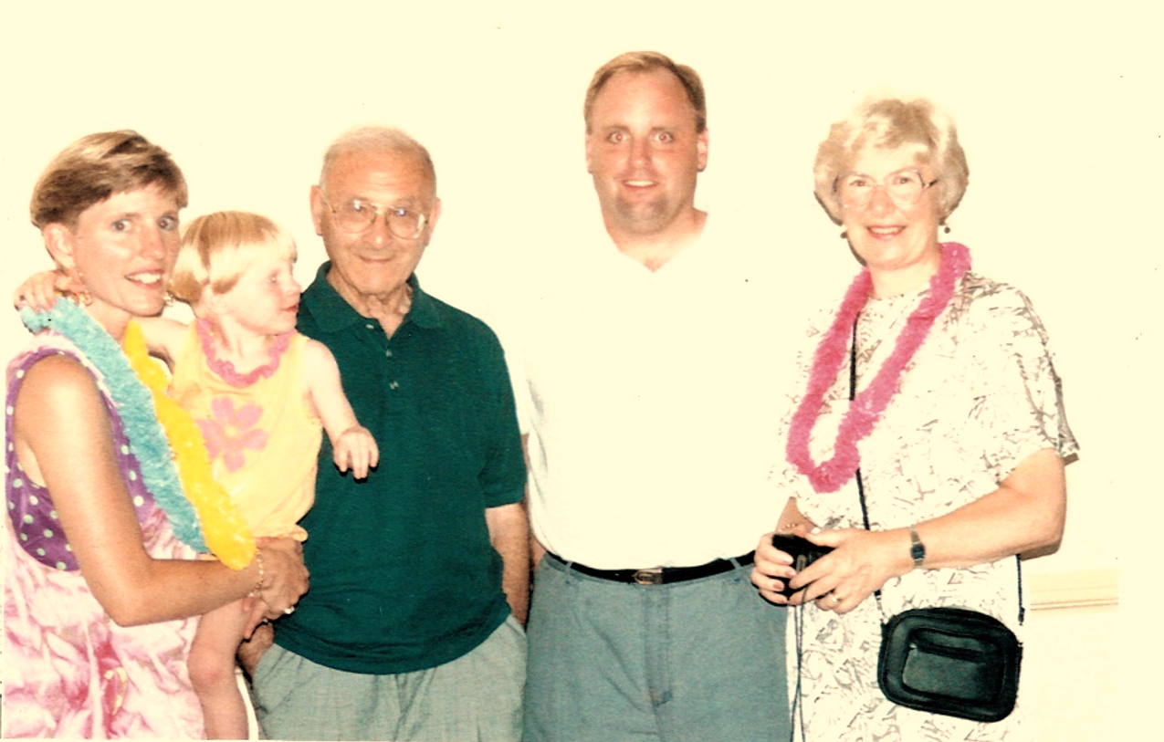
Discovered in 1965 by Dr. Harry Angelman
1982: AS Diagnosis
1987: Genetic Marker Identified
1991: First Major Gift – ASF begins
1996: First Clinical Trial – Wagstaff
2018: $10 Million Milestone
3 full-time + 3 hourly employees
Notes:
British Pediatrician
1965 published first paper identifying the disorder
First support group for Angelman Syndrome not until 1986
Formal research didn’t begin until the 1990’s
We have come a long way since then!

Slide 3
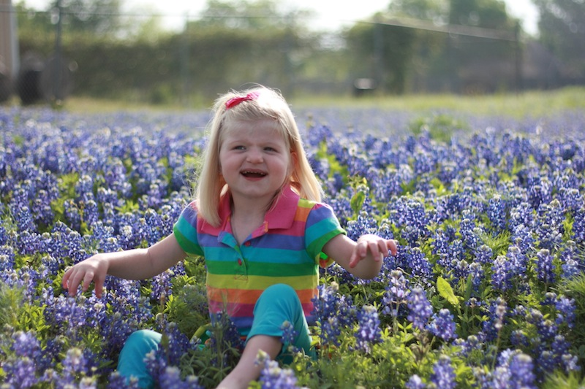
Characteristics of Angelman Syndrome
Notes:
Many children misdiagnosed as having severe autism or cerebral palsy
True diagnosis of AS takes a genetic test
UB3A Gene – Specifically chromosome #15
Unlike other disorders/diseases, we know EXACTLY what causes Angelman syndrome.
This makes the search for a cure quite possible within our lifetime
But what are some general similarities/characteristics?

Slide 4
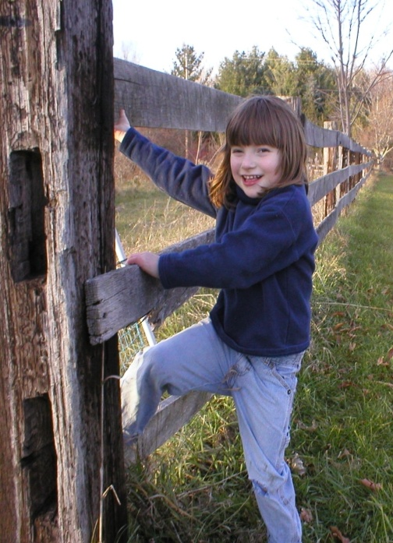
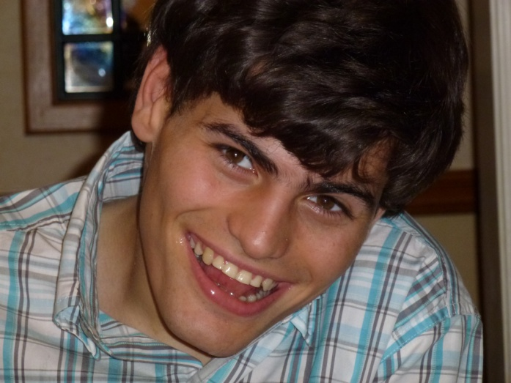
Angelman Syndrome
All races and ethnicities
Boys and girls equally
1:15,000
Rare disorder = <200,000
Notes:
Less than 200,000 in the USA
Quite possibly many more children and young adults out there that have AS, but are living with a misdiagnosis
Often doctors label it as “severe autism or cerebral palsy” without doing a genetic test.

Slide 5
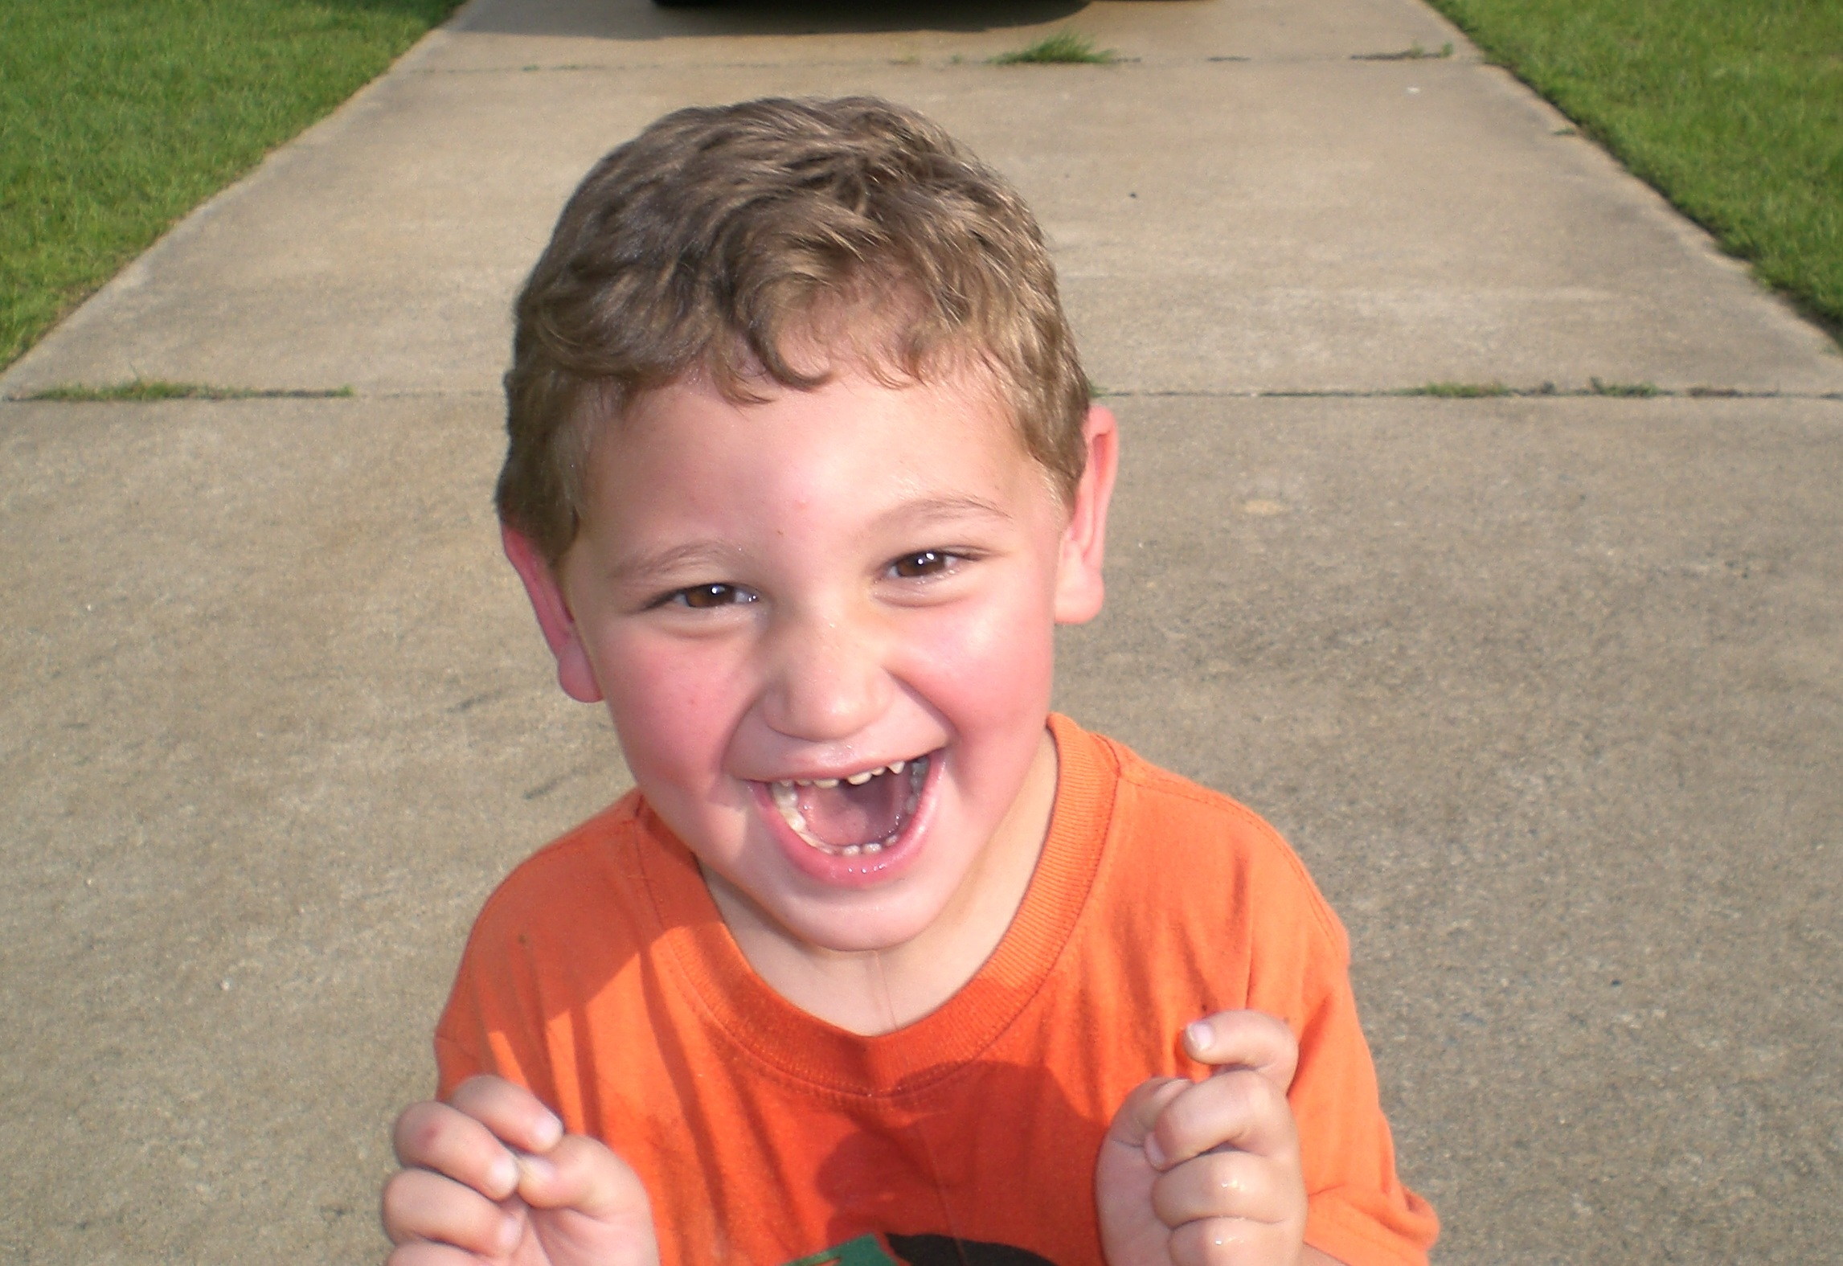
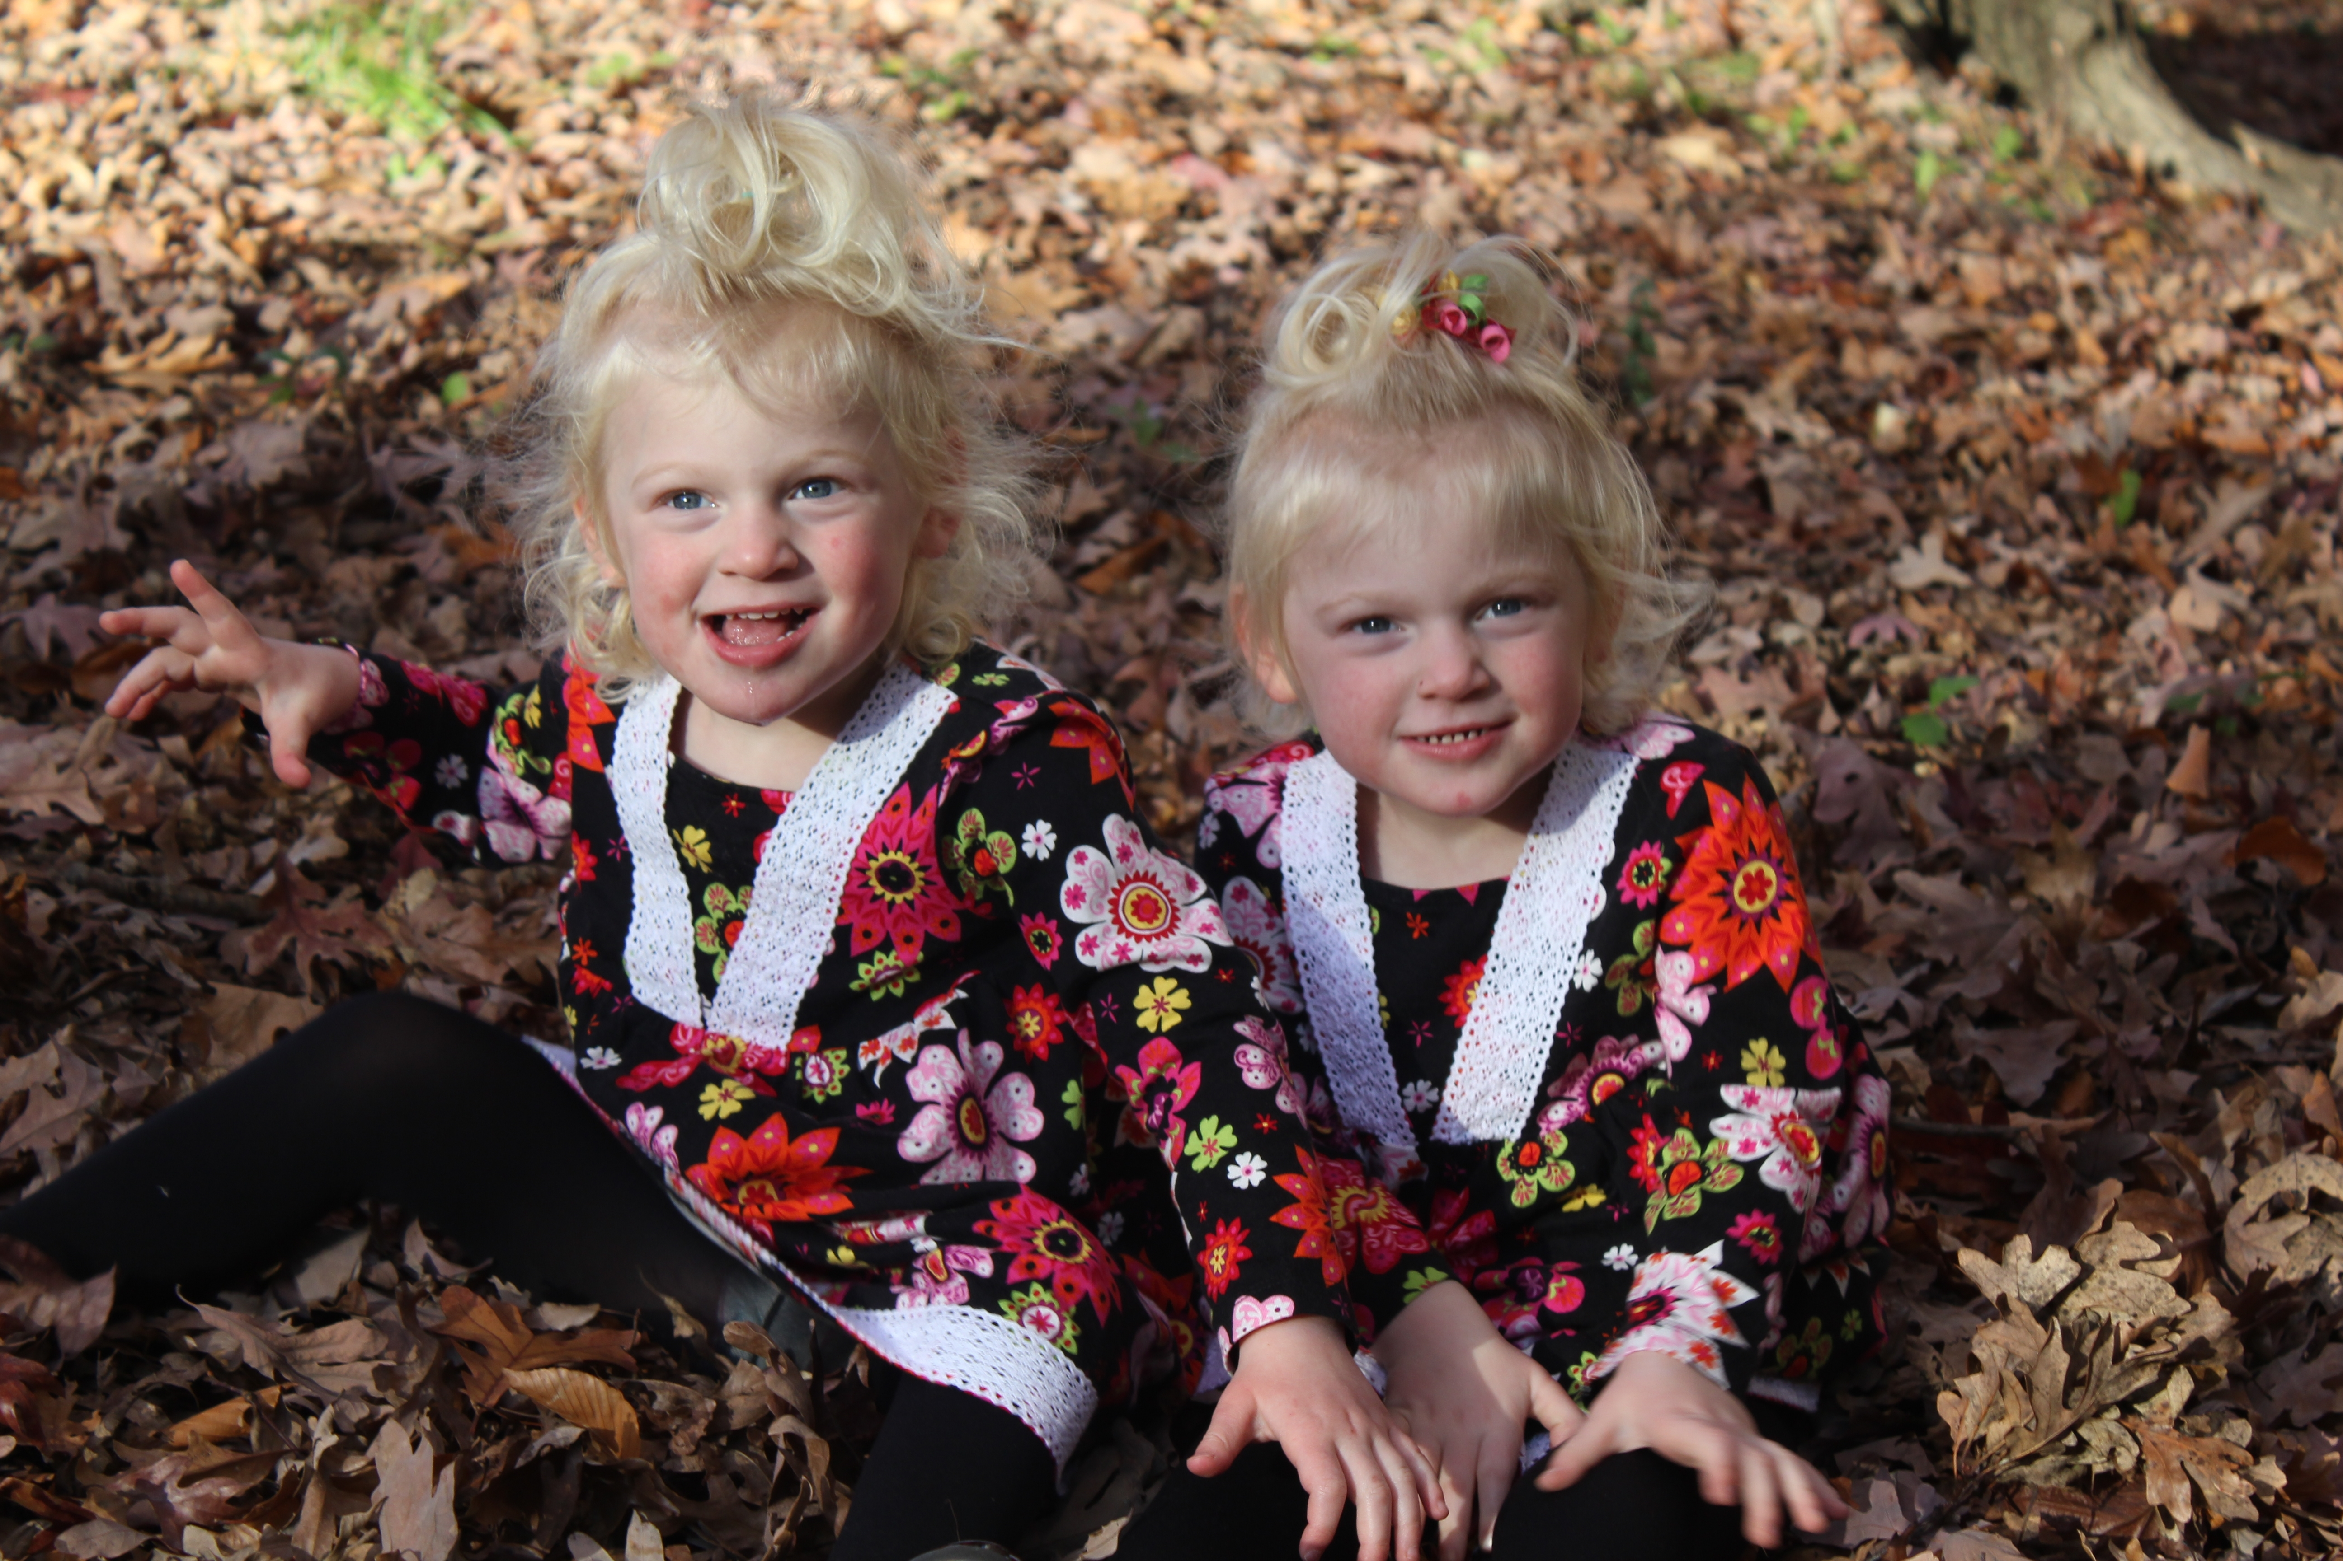
Characteristics of Angelman Syndrome
Can’t talk
Seizures ≥80%
Notes:
Greater than 80% experience seizures usually by age 3

Slide 6
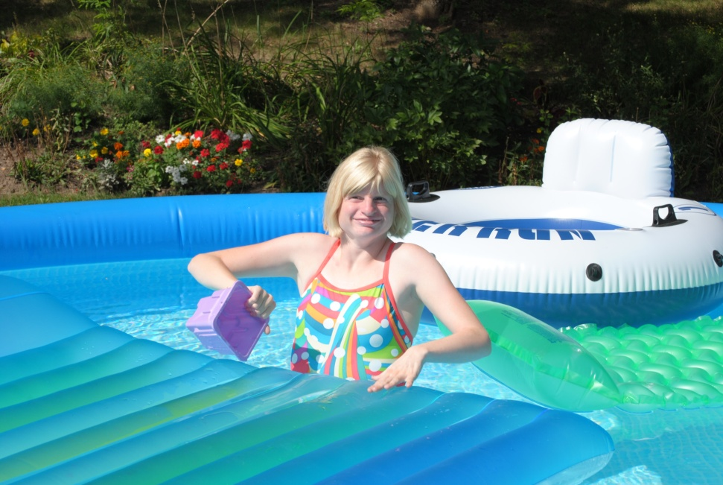
Characteristics of Angelman Syndrome
Fascination with water
Notes:
We don’t know exactly why, but pretty close to ALL individuals with AS have an unusual attraction/fascination with water.

Slide 7
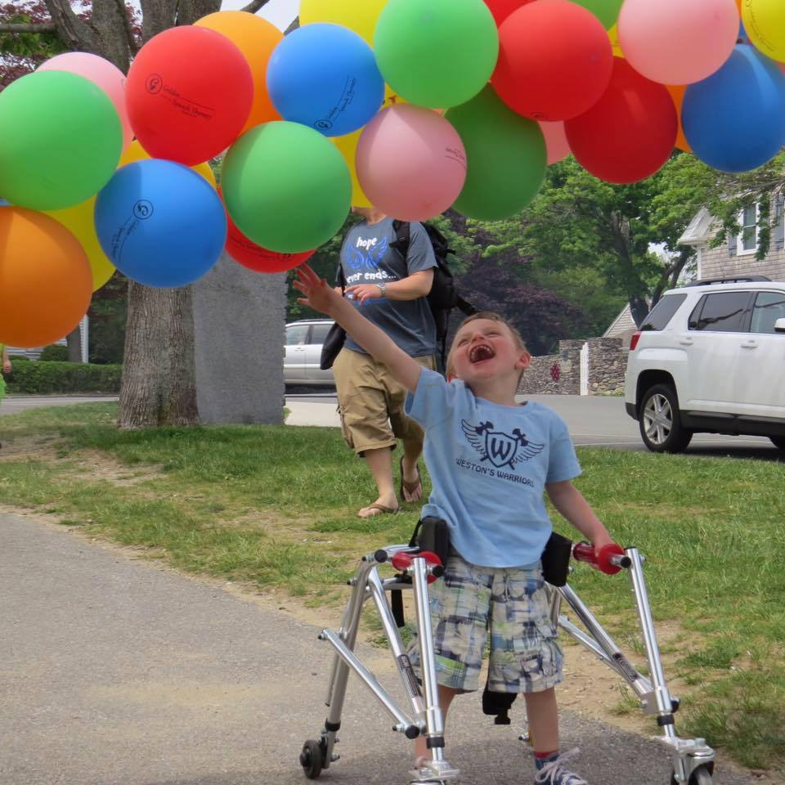
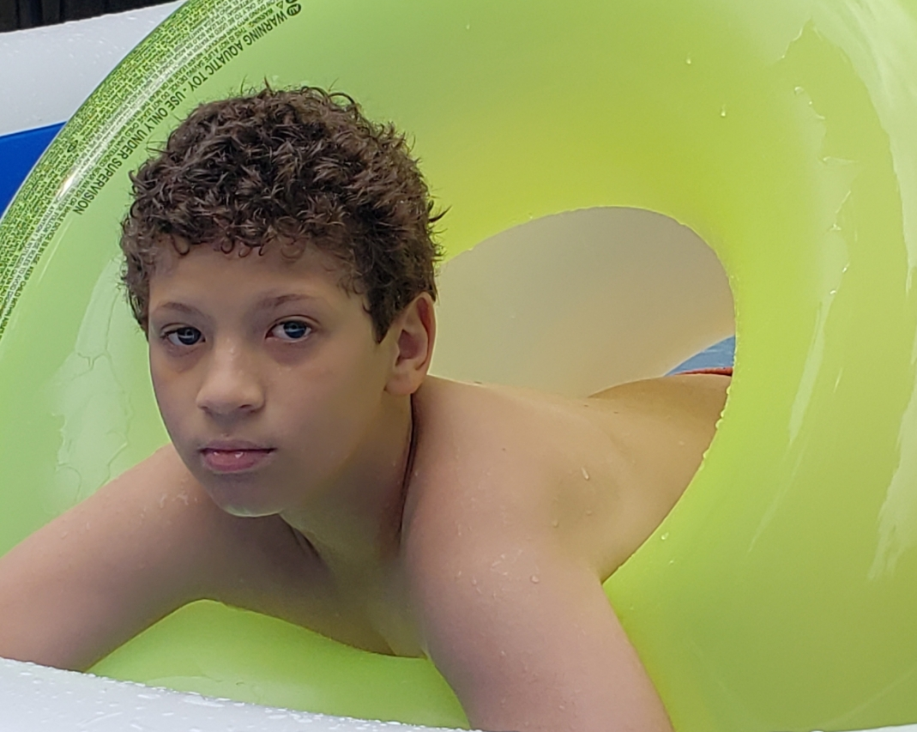
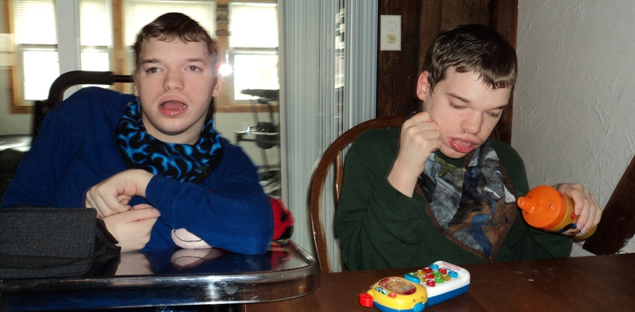
Characteristics of Angelman Syndrome
Hard time with walking and balance
Difficulty learning and understanding
Notes:
“difficulty learning & understanding” is a term directly from the textbooks. It is likely they understand a lot more than we give them credit for.

Slide 8
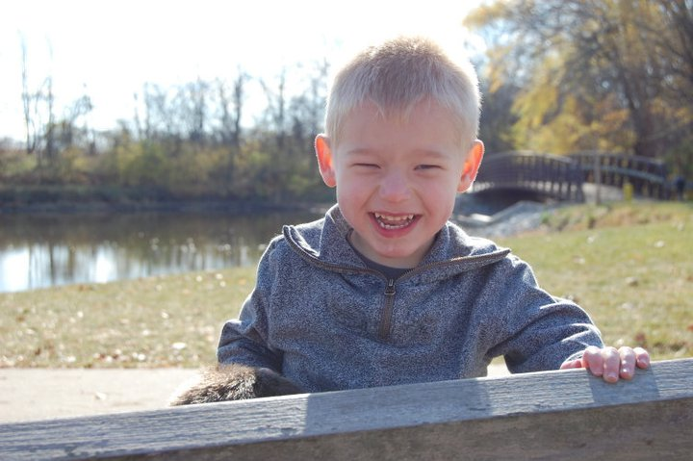
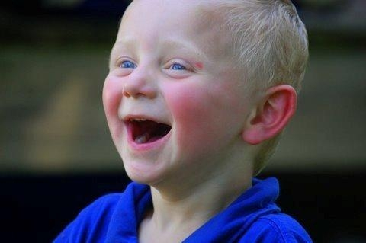
Characteristics of Angelman Syndrome
Happy, engaging, social – especially when younger
Notes:
Puberty sometimes changes the happy demeanor for individuals with AS.
This causes many adolescent behavior challenges

Slide 9
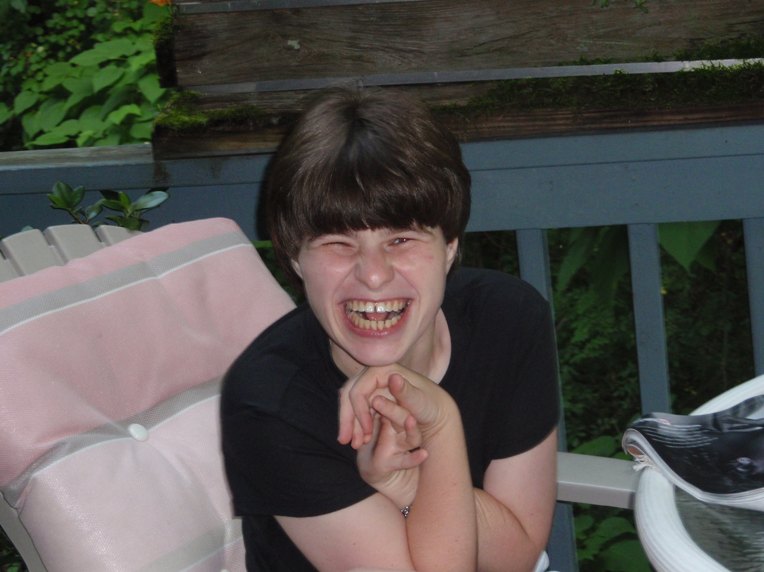
Characteristics of Angelman Syndrome
Need to be cared for all of their lives
Notes:
Individuals with AS will need round the clock care for the rest of their life

Slide 10
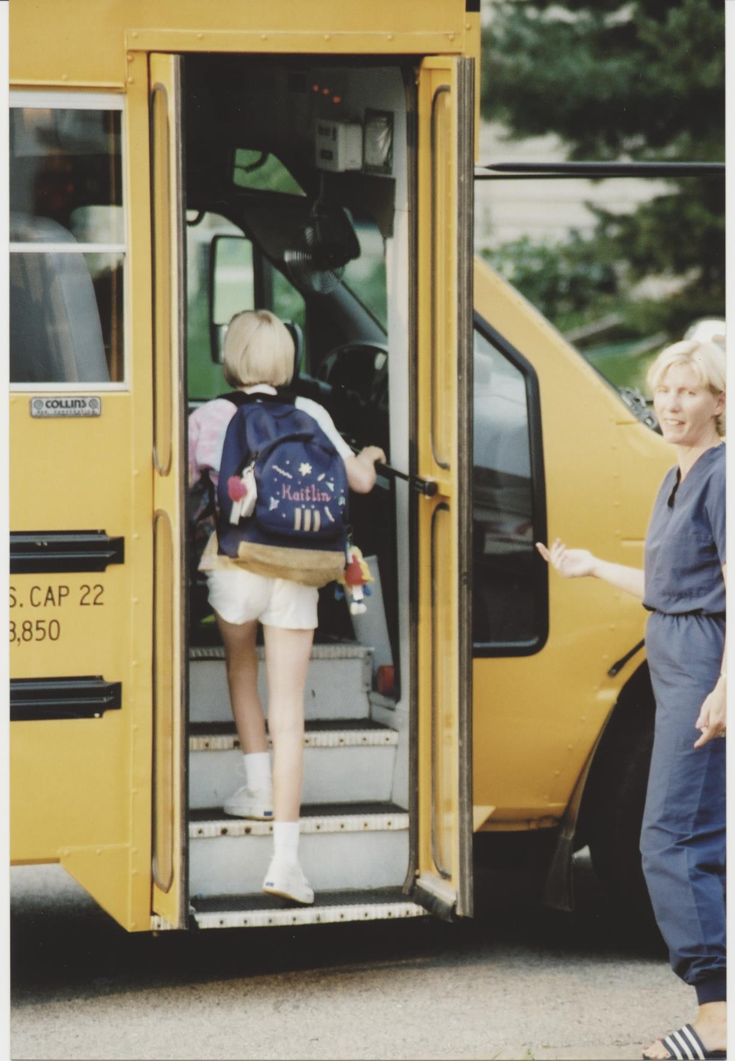
Life with Angelman syndrome
Doctors
Physical Therapy
Occupational Therapy
Ophthalmologists
Gastroenterologist
Speech Therapy
Neurologists
ENTs
Notes:
The cost to raise a typical child is somewhere around $300,000
The cost to raise a child with AS is over $3million
Significantly more expensive to raise a child with AS

Slide 11
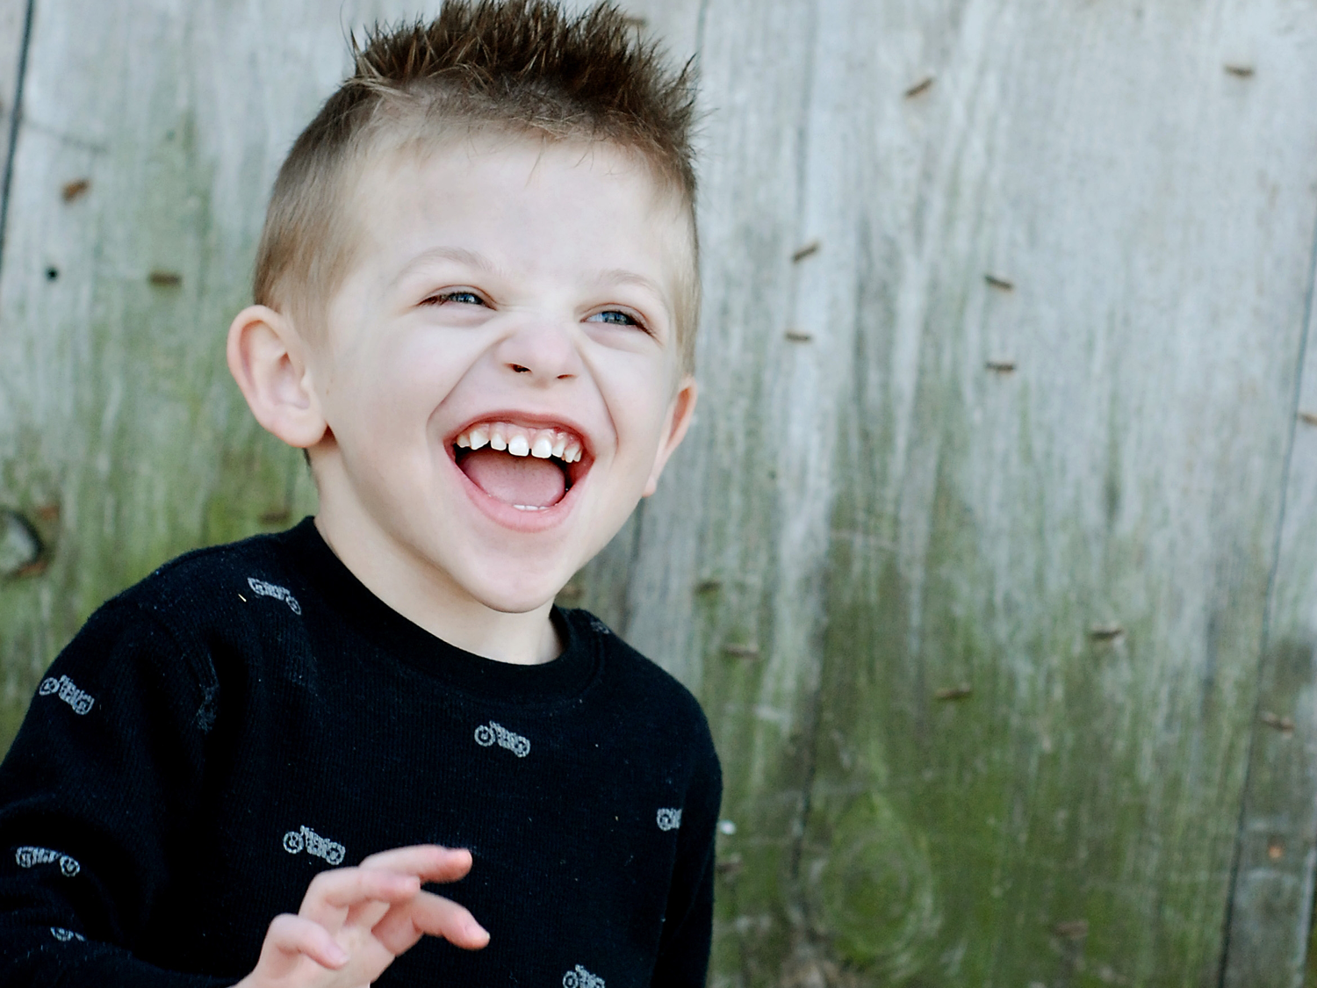
WHAT CAUSES
ANGELMAN SYNDROME?

Slide 12
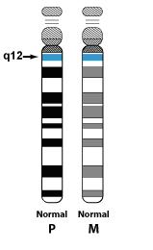
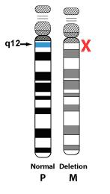
What We Know About
Angelman Syndrome
Normal #15
Chromosomes
Deletion of part of
#15 Chromosome
Notes:
We have 22 chromosomes.
There is a male and a female component to each one
Angelman syndrome only affects one chromosome in our gene – that is chromosome #15, or UB3a
The left side shows a normal gene with a normal #15 chromosome.
The father’s chromosome #15 becomes ‘turned off’ or dormant
The right side depicts what happens when AS is caused
The fathers chromosome #15 is ‘turned off’ so to speak
The mother’s chromosome #15 is supposed to take over
AS happens when the mother’s chromosome #15 either is damaged or missing completely.

Slide 13
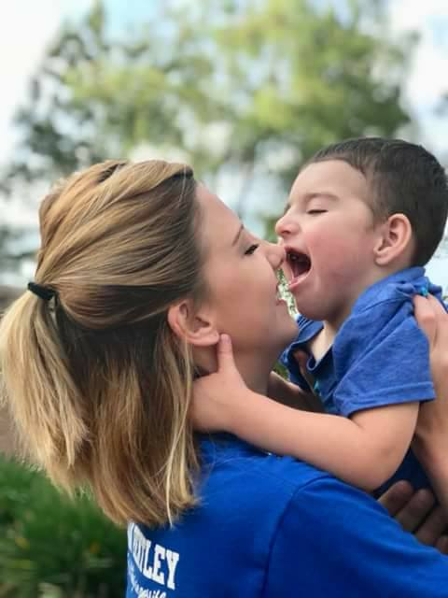
Our Mission is Three-Fold:
Research + Family Clinics +
Family Support
We are the family’s 1st Point of Contact
They Look to Us For:
Advice
Education
Family support
Resources
Notes:
Approximately 70% of the Walk funds we receive do go directly towards the ASF Mission.
Our Mission is three-fold.
Research for a cure is a critical aspect of our purpose
The other critical thing we do is family support. Providing education, resources and financial help through the ASF Family Fund
The ASF is the 1st point of contact when a family receives a diagnosis. Often they are devastated.
They look to us for:
Angelman Syndrome A to Z
Employment Resources
Household Resources
Support Resources
Financial Resources
Inclusion Resources
Seizure Resources
Therapy Resources
The ASF has recently (in the last 7 years) began AS Clinics nationwide.
We currently have 17 AS Clinics in the U.S. and this number is growing quickly
AS Clinics give comprehensive care to AS individuals (Neurological, PT, OT, and more)

Slide 14
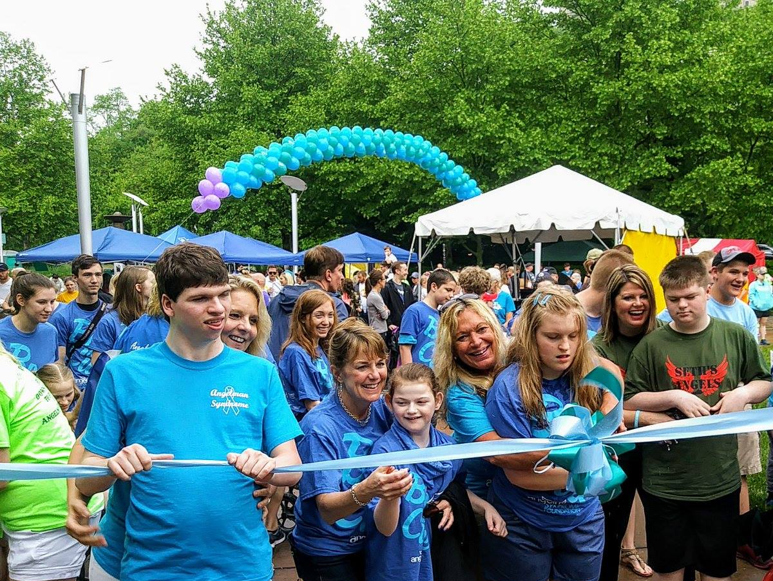
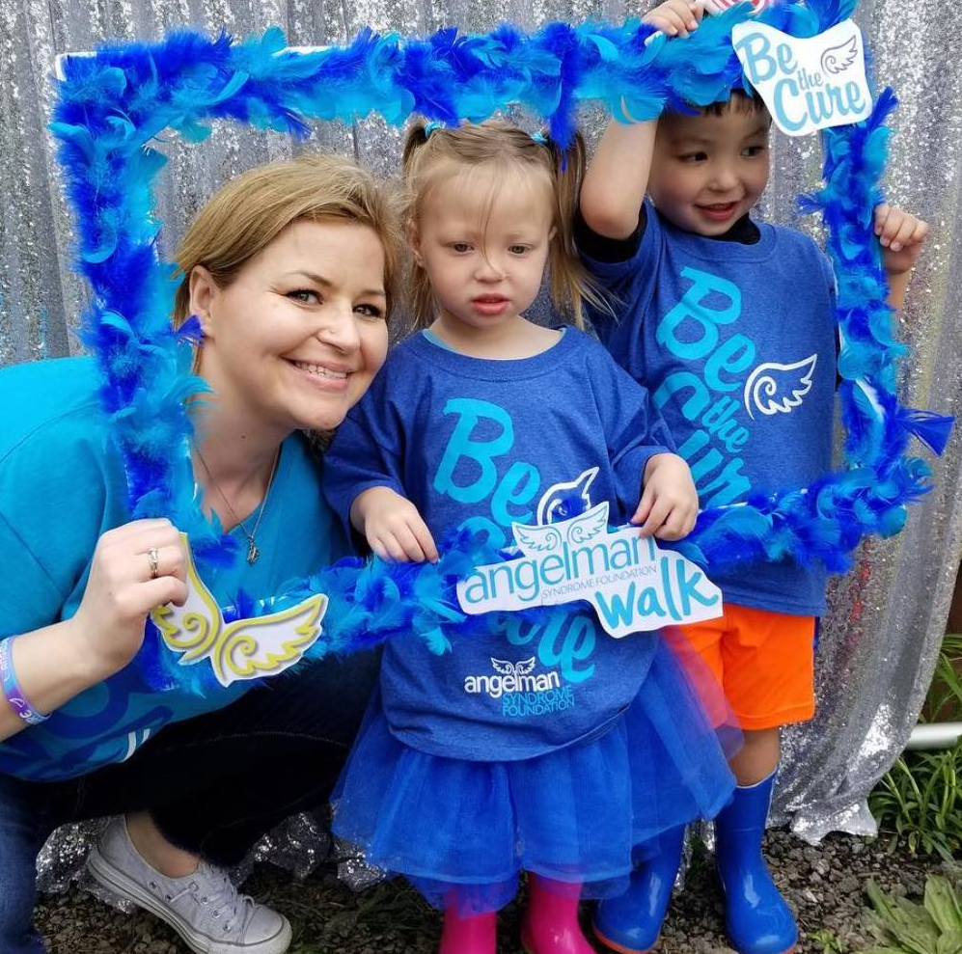
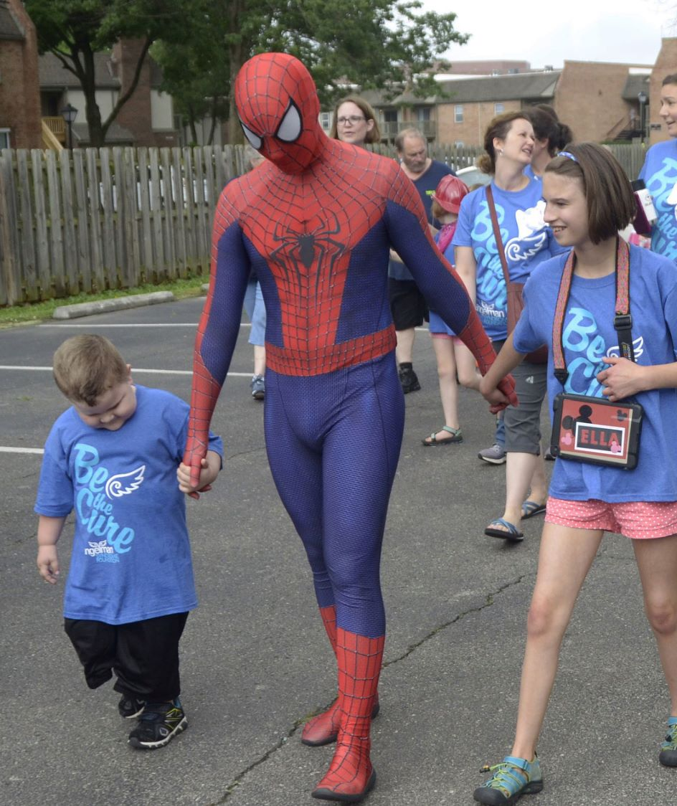
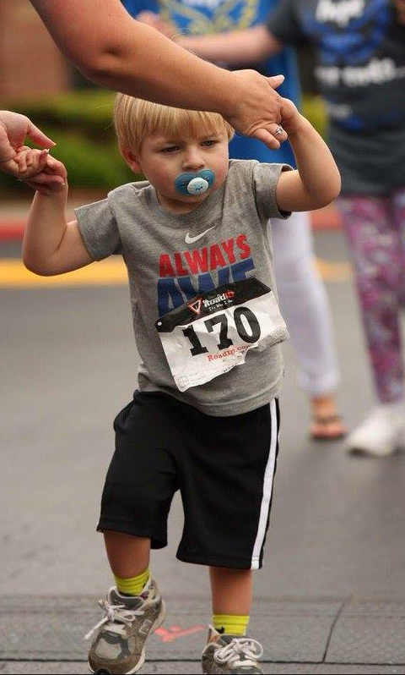
May 21, 2022
ASF National Walk
50+ Cities Nationwide
Virtual Walks in all states & globally
Notes:
The National Walk is our #1 Fundraiser and source of income
We also count on grassroots fundraising and people/families/organizations like YOU.

Slide 15
Thank You!
More information:
kmurphy@angelman.org
630-978-4245 or 800-432-6435 (800-IF-ANGEL)
www.angelman.org

